Slide 1



Sudoku solver
JAIHARI D (19ITR028)
HEMANTH V
23ADR061
AIDS - A

Slide 2

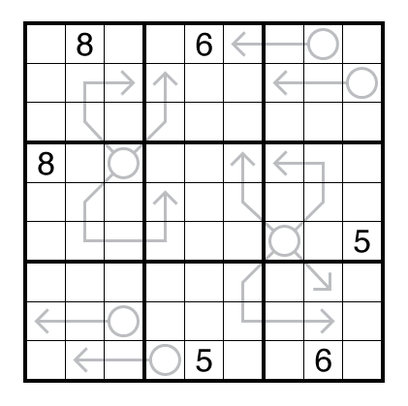
1. The puzzle consists of a 9x9 grid, making 81 cells in total.
2. The grid is divided into 9 smaller 3x3 sub grids.
3. Every 3x3 sub grids doesn’t contains dupliate values

Slide 3
Objectives
The goal of Sudoku is to fill the entire 9x9 grid with digits from 1 to 9, ensuring that:
Each row contains each number exactly once.
Each column contains each number exactly once.
Each 3x3 sub grid contains each number exactly once
3

Slide 4
Modules Tools Used
Modules
1. Util Scanner - to get Input
2. Java math - To use math functions
Concepts
OOP’S Concept
Inheritance Recursion
Interfaces Input Validation and Error Handling
Abstract Methods Conditional Statements
Encapsulation Method Overriding
Backtracking Algorithm Static Methods
2D Arrays Loops (Iteration)
4

Slide 5
Implementation Details
import java.util.Scanner;
// Interface for the Sudoku solver
interface SudokuSolverInterface {
boolean solve(int[][] board);
}
// Abstract class implementing the interface
abstract class AbstractSudokuSolver implements SudokuSolverInterface {
// Checks if placing a number in a cell is valid
protected boolean isValid(int[][] board, int row, int col, int num) {
// Check row and column
for (int i = 0; i < 9; i++) {
if (board[row][i] == num || board[i][col] == num) {
return false;
}
}
// Check 3x3 grid
int startRow = row - row % 3, startCol = col - col % 3;
for (int i = 0; i < 3; i++) {
for (int j = 0; j < 3; j++) {
if (board[i + startRow][j + startCol] == num) {
return false;
}
}
}
}
return true;
}
// Prints the Sudoku board
protected void printBoard(int[][] board) {
for (int i = 0; i < 9; i++) {
for (int j = 0; j < 9; j++) {
System.out.print(board[i][j] + " ");
}
System.out.println();
}
}
}
// Concrete class implementing the Sudoku solver using backtracking
class SudokuSolver extends AbstractSudokuSolver {
// Recursive backtracking method to solve Sudoku
@Override
public boolean solve(int[][] board) {
for (int row = 0; row < 9; row++) {
for (int col = 0; col < 9; col++) {
if (board[row][col] == 0) { // Find an empty cell
5

Slide 6
for (int num = 1; num <= 9; num++) {
if (isValid(board, row, col, num)) { // Check if the number is valid
board[row][col] = num; // Place the number
if (solve(board)) return true;
board[row][col] = 0; // Backtrack
}
}
return false; // Trigger backtracking
}
}
}
return true; // Puzzle solved
}
}
public class sudoku {
public static void main(String[] args) {
Scanner scanner = new Scanner(System.in);
int[][] board = new int[9][9];
System.out.println("Enter the Sudoku puzzle (use 0 for empty cells):");
for (int i = 0; i < 9; i++) {
System.out.print("Enter value for cell (" + (i + 1) + ", " + (j + 1) + "): ");
if (scanner.hasNextInt()) {
value = scanner.nextInt();
if (value >= 0 && value <= 9) {
// Validate if the number is already present in the same row, column, or 3x3 grid
if (value != 0 && !isValidInput(board, i, j, value)) {
System.out.println("Error: Duplicate number found in row, column, or 3x3 grid. Please enter a different number.");
} else {
board[i][j] = value;
break;
}
} else {
System.out.println("Error: Please enter a number between 0 and 9.");
}
} else {
System.out.println("Error: Invalid input. Please enter a numeric value.");
scanner.next(); // Clear invalid input
}
}
}
}

Slide 7
SudokuSolver solver = new SudokuSolver();
System.out.println("\nAttempting to solve the puzzle...\n");
if (solver.solve(board)) {
System.out.println("Solved Sudoku:");
solver.printBoard(board);
} else {
System.out.println("This Sudoku puzzle is unsolvable.");
}
scanner.close();
}
// Method to check if input is valid in row, column, and 3x3 grid
private static boolean isValidInput(int[][] board, int row, int col, int num) {
// Check row and column for duplicates
for (int i = 0; i < 9; i++) {
if (board[row][i] == num || board[i][col] == num) {
return false;
}
}
// Check 3x3 grid for duplicates
int startRow = row - row % 3;
int startCol = col - col % 3;
for (int i = 0; i < 3; i++) {
for (int j = 0; j < 3; j++) {
if (board[i + startRow][j + startCol] == num) {
return false;
}
}
}
return true;
}
}

Slide 8
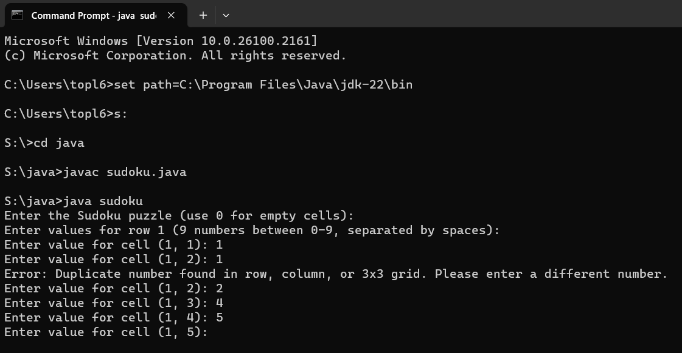
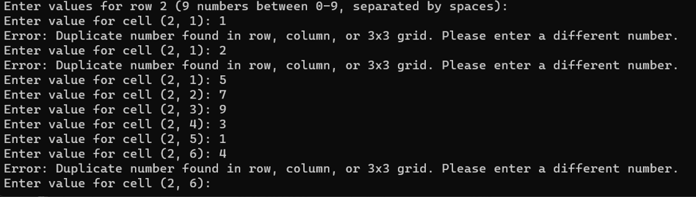
output

Slide 9
Thank you!

